Slide 1
Loh Yip Khai
Data Integration for Road Safety and Health Analysis

Slide 2
URL
https://www.lta.gov.sg/content/dam/ltagov/who_we_are/statistics_and_publications/statistics/pdf/M06-Vehs_by_Type.pdf
https://beta.data.gov.sg/collections/1399/view
https://beta.data.gov.sg/collections/505/view

Slide 3
Age Distribution of Motor Vehicles:
This dataset provides insights into the age distribution of motor vehicles in the region. It includes information on the number of vehicles in different age categories, their types (e.g., cars, trucks).

Slide 4
Top 10 Reasons of Hospitalization:
This dataset outlines the top 10 medical conditions that lead to hospitalizations. It includes information on the frequency of hospitalizations for each condition, and the percentage discharged.

Slide 5
Total Casualties:
This dataset contains information on the number of fatalities and injuries, those who got injured and died.

Slide 6
Total Fatalities:
This dataset contains the number of fatalities, those who died.

Slide 7
Total Monthly Rainfall:
This dataset records the monthly total rainfall in the area over the same period as the other datasets. It includes information on the amount of rainfall,

Slide 8
Total Number Of Road Accidents:
The vehicle count of the number of vehivles involved int the accident

Slide 9
Vehicles Involved In Accidents:
This dataset contains information on the total number of the different types of vehicles involved in the accident.

Slide 10
Research into area
Goals:
1. To understand the impact of weather(Rainfall) on road accidents
2. Find a pattern between Accidents and Casualties
3. Find out the number of casualties by vehicles during an accident
4. Compare the number of casualties VS fatalities between vehicles
5. Find out the distribution of vehicles involved in accidents
6. Find out if the population of vehicle(s) reflect how many accidents occur of that vehicle(s)
7. Find out if the number of people hospitalise come from accidents

Slide 11
Visualising Data
Using Pandas and matplotlib to visualise the Datasets

Slide 12
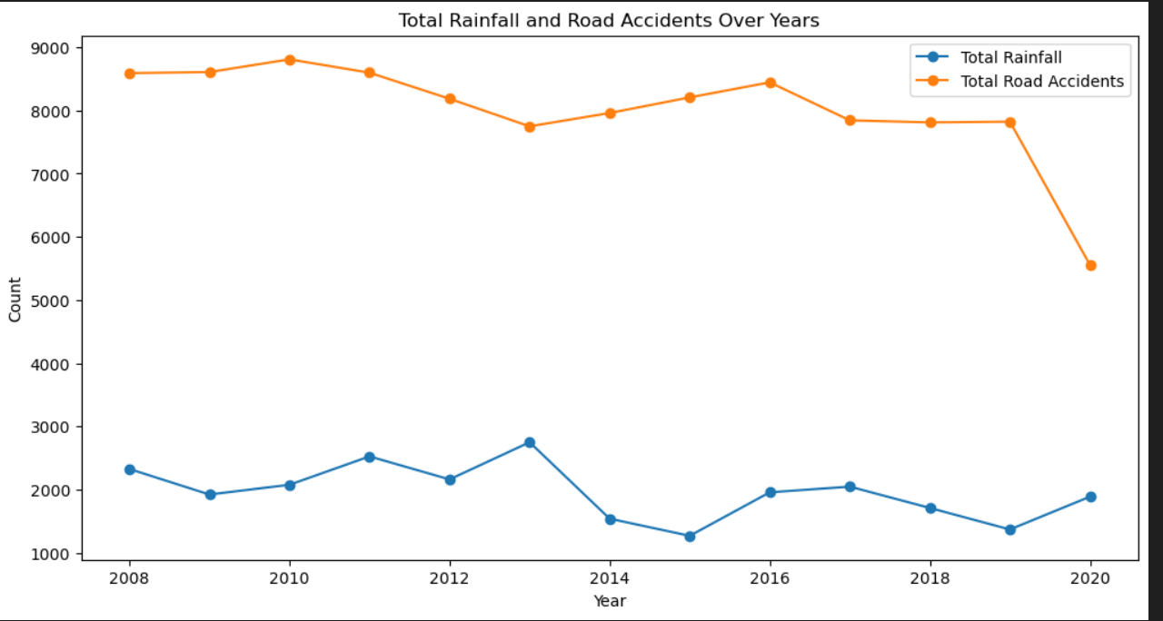
Total Rainfall VS Road Accidents
I used a line plot to visualize the data, from here I can see that as the rainfall increased, the number of accidents actually decreased.
This proves that weather does not really affect road accidents

Slide 13
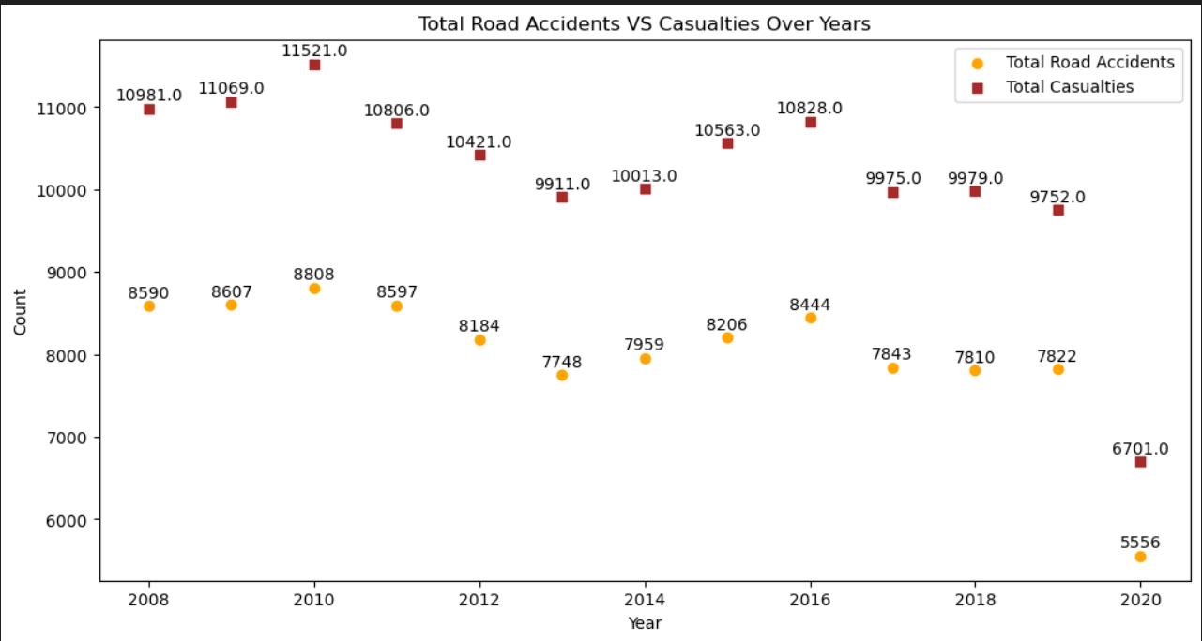
Total Road Accidents VS Casualties Over Years
I used a Scatter plot, and I can see that there is a positive correlation between both variables
As road accidents increased, so does total casualties and vice-versa

Slide 14
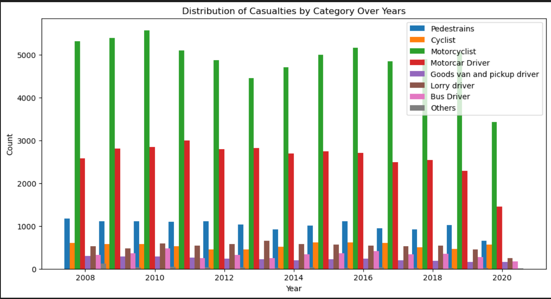
Distribution by Casualties Over Year
I used a bar plot, and I found out that motorcyclist has the most casualties, with motorcar drivers in second.
This shows that motorcyclists had sustained the most casualties out of all the types of drivers

Slide 15
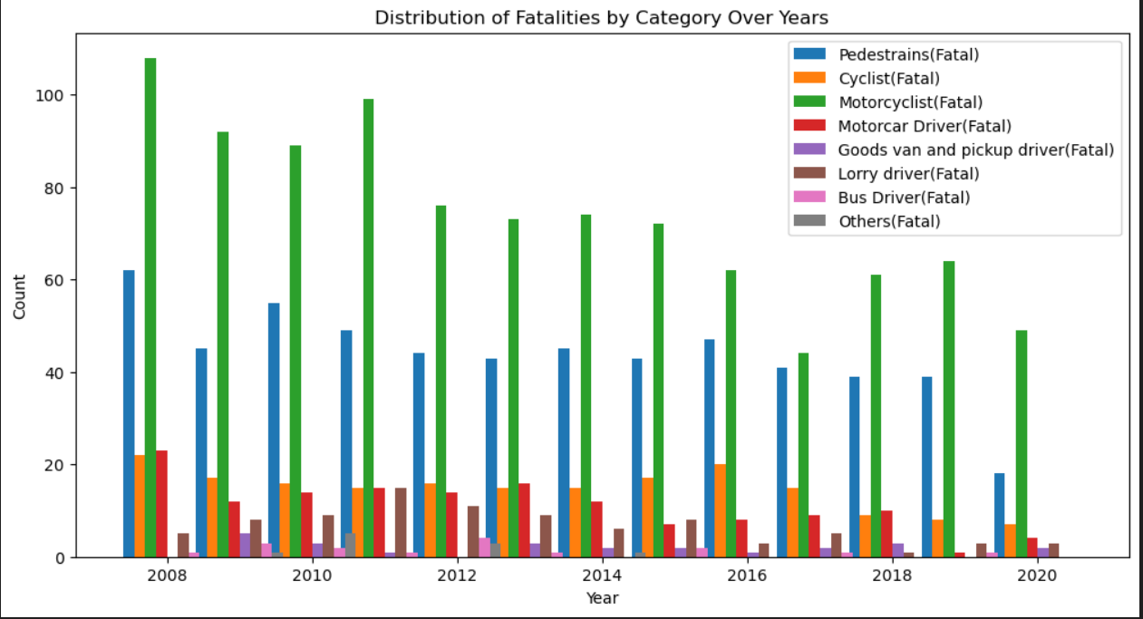
Distribution of Fatalities by Category Over the Years
I used bar plot, and from here I can once again see that motorcyclist has the most fatalities, similar to the casualties.
However, pedestrians has the second most casualties after motorcyclists, which was a surprise.
Motorcars drivers came in third that suffered the most fatalities

Slide 16
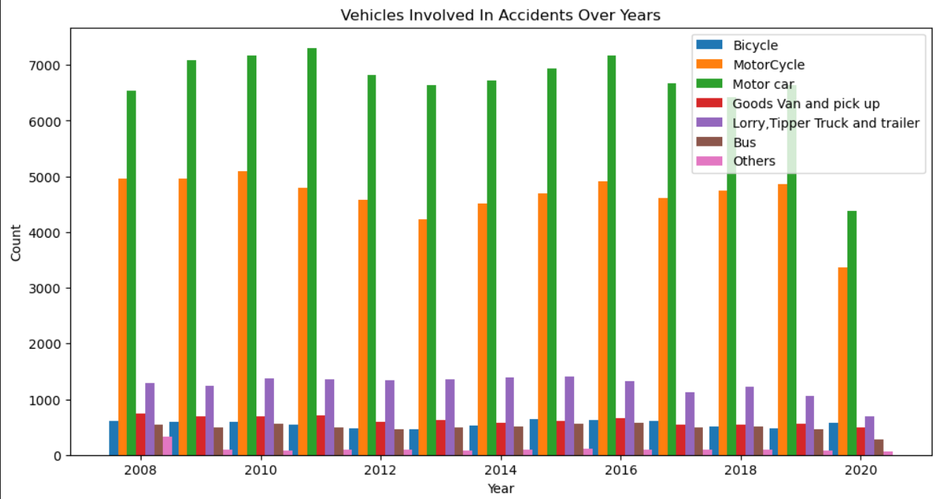
Vehicles Involved in Accidents
I used bar plot, and I found out that surprisingly motorcars was the vehicle involved in the most amount of accidents
I had expected motorcycle to be number 1 since it has the most number of casualties and fatalities

Slide 17
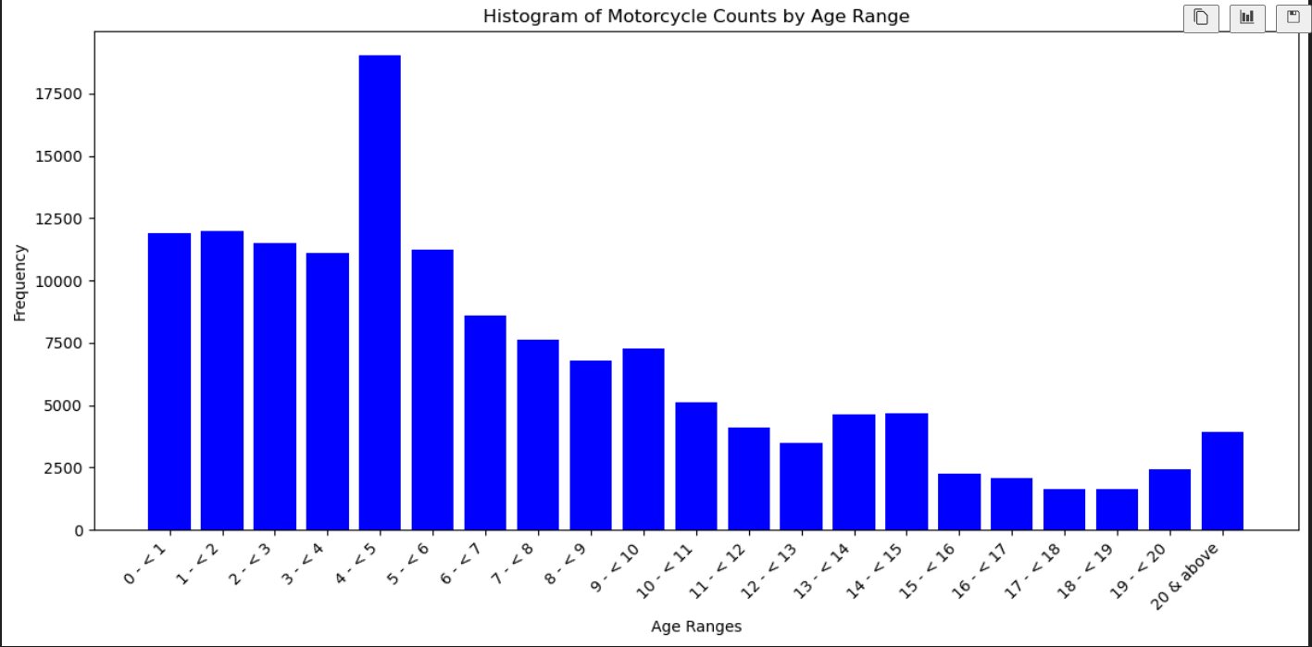
Histogram/bar plot of motorcyclist by age of motorcycle
I used bar plot for this, but I wanted to represent a histogram.
From the graph, we can see that the highest frequency motorcycle that people bought was around age(4 - < 5) years old motorcycles
This could suggest people were relatively experienced drivers although accidents involving motorcyclist was still the one of the most prevalent accidents that occur most frequently

Slide 18
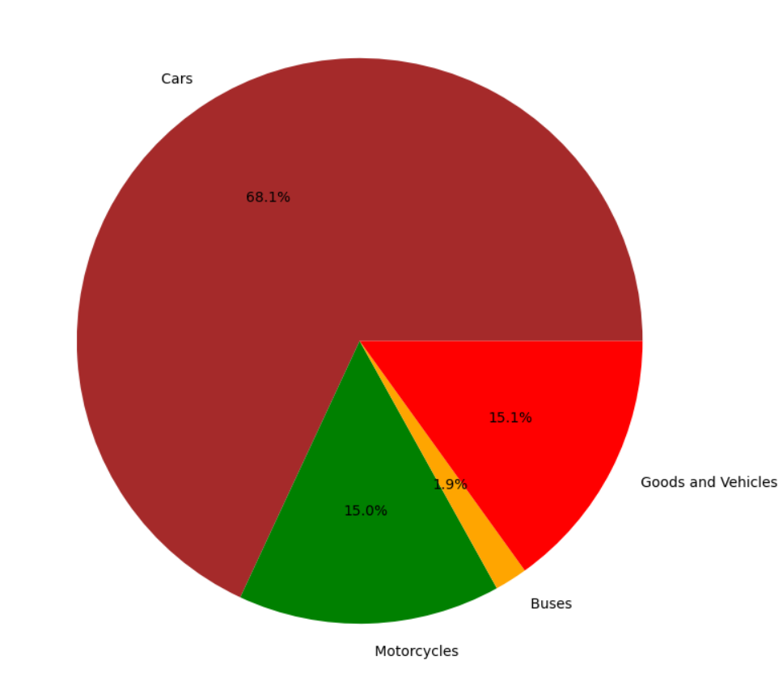
Distribution of vehicles by population
From the pie chart, we can see that motorcars was the most, followed by goods and vehicles and motorcycles.
This is surprising as motorcycles has the third highest population but had actually caused the most number of casualties and fatalities during accidents

Slide 19
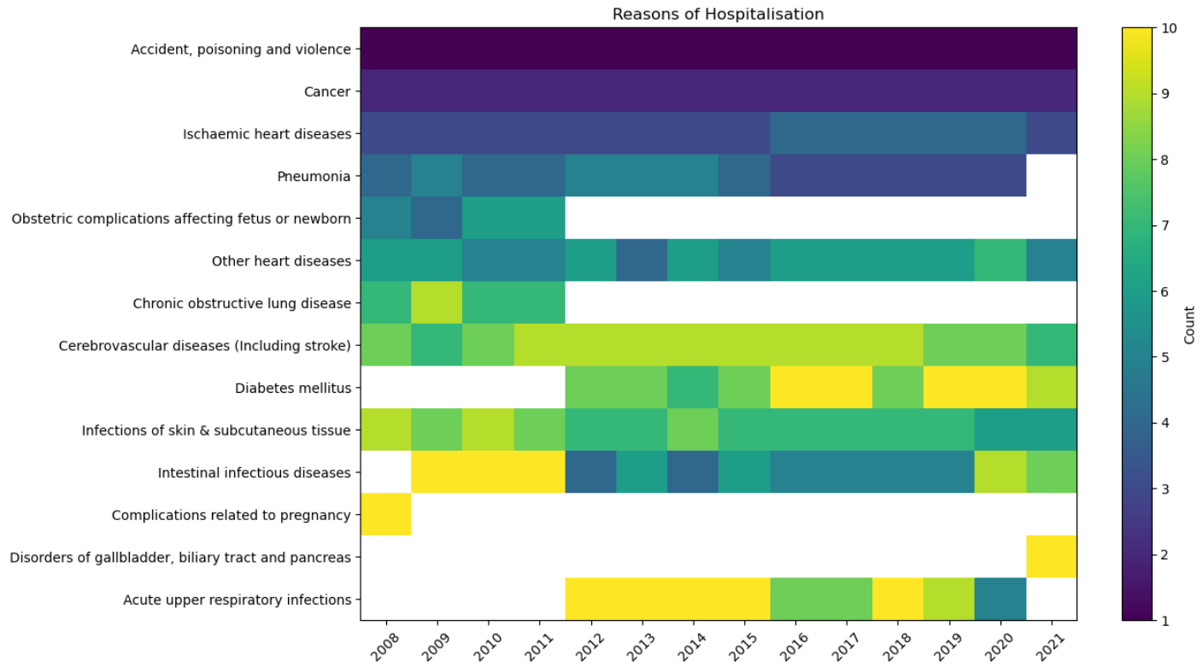
Reasons of hospitalisation
From the heatmap, we can see that the number 1 ranked cause of hospitalization is accidents, poisoning and violence.
This suggest that there is a high percentage of people that may have got sent to hospital because there were involved in a road accident

Slide 20
Conclusion
After visualising the data with pandas and mathplotlib, I have realised that
Goals:
1. To understand the impact of weather(Rainfall) on road accidents
There is not really an impact.
2. Find a pattern between Accidents and Casualties
Positive correlation.
3. Find out the number of casualties by vehicles during an accident
Motorcyclist, follow by motorcars

Slide 21
Conclusion(continued)
4. Compare the number of casualties VS fatalities between vehicles
Motorcyclist, pedestrians then motorcars
5. Find out the distribution of vehicles involved in accidents
Motorcars, followed by motorcyclists
6. Find out if the population of vehicle(s) reflect how many accidents occur of that vehicle(s)
Motorcycle ranked third, but caused the most number of casualties/fatalities
7. Find out if the top reason people get hospitalised come from accidents
Yes, and ranked at number 1

